Slide 1

Nationwide Digital Twin: Innovation for Resilience and Sustainability
Markus Eisenhauer
  SMARTGREENS 2021
  April 30, 2021

Slide 2

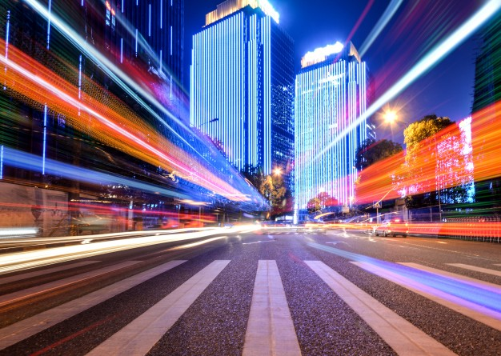
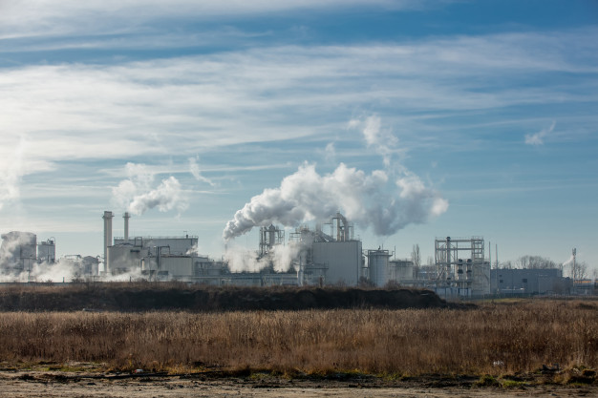
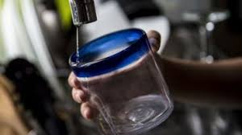



The world in 2030
Population
8,5 billion people
1 billion over 65 yrs
Urbanization
2/3 population in cities
Resource pressure
3-4 billion people
experienced water stress
Raw materials scarcity
Technology Shifts
125 billion connected devices
15 million manufacturing cobots
Climate Change
+ 2°C

Slide 3
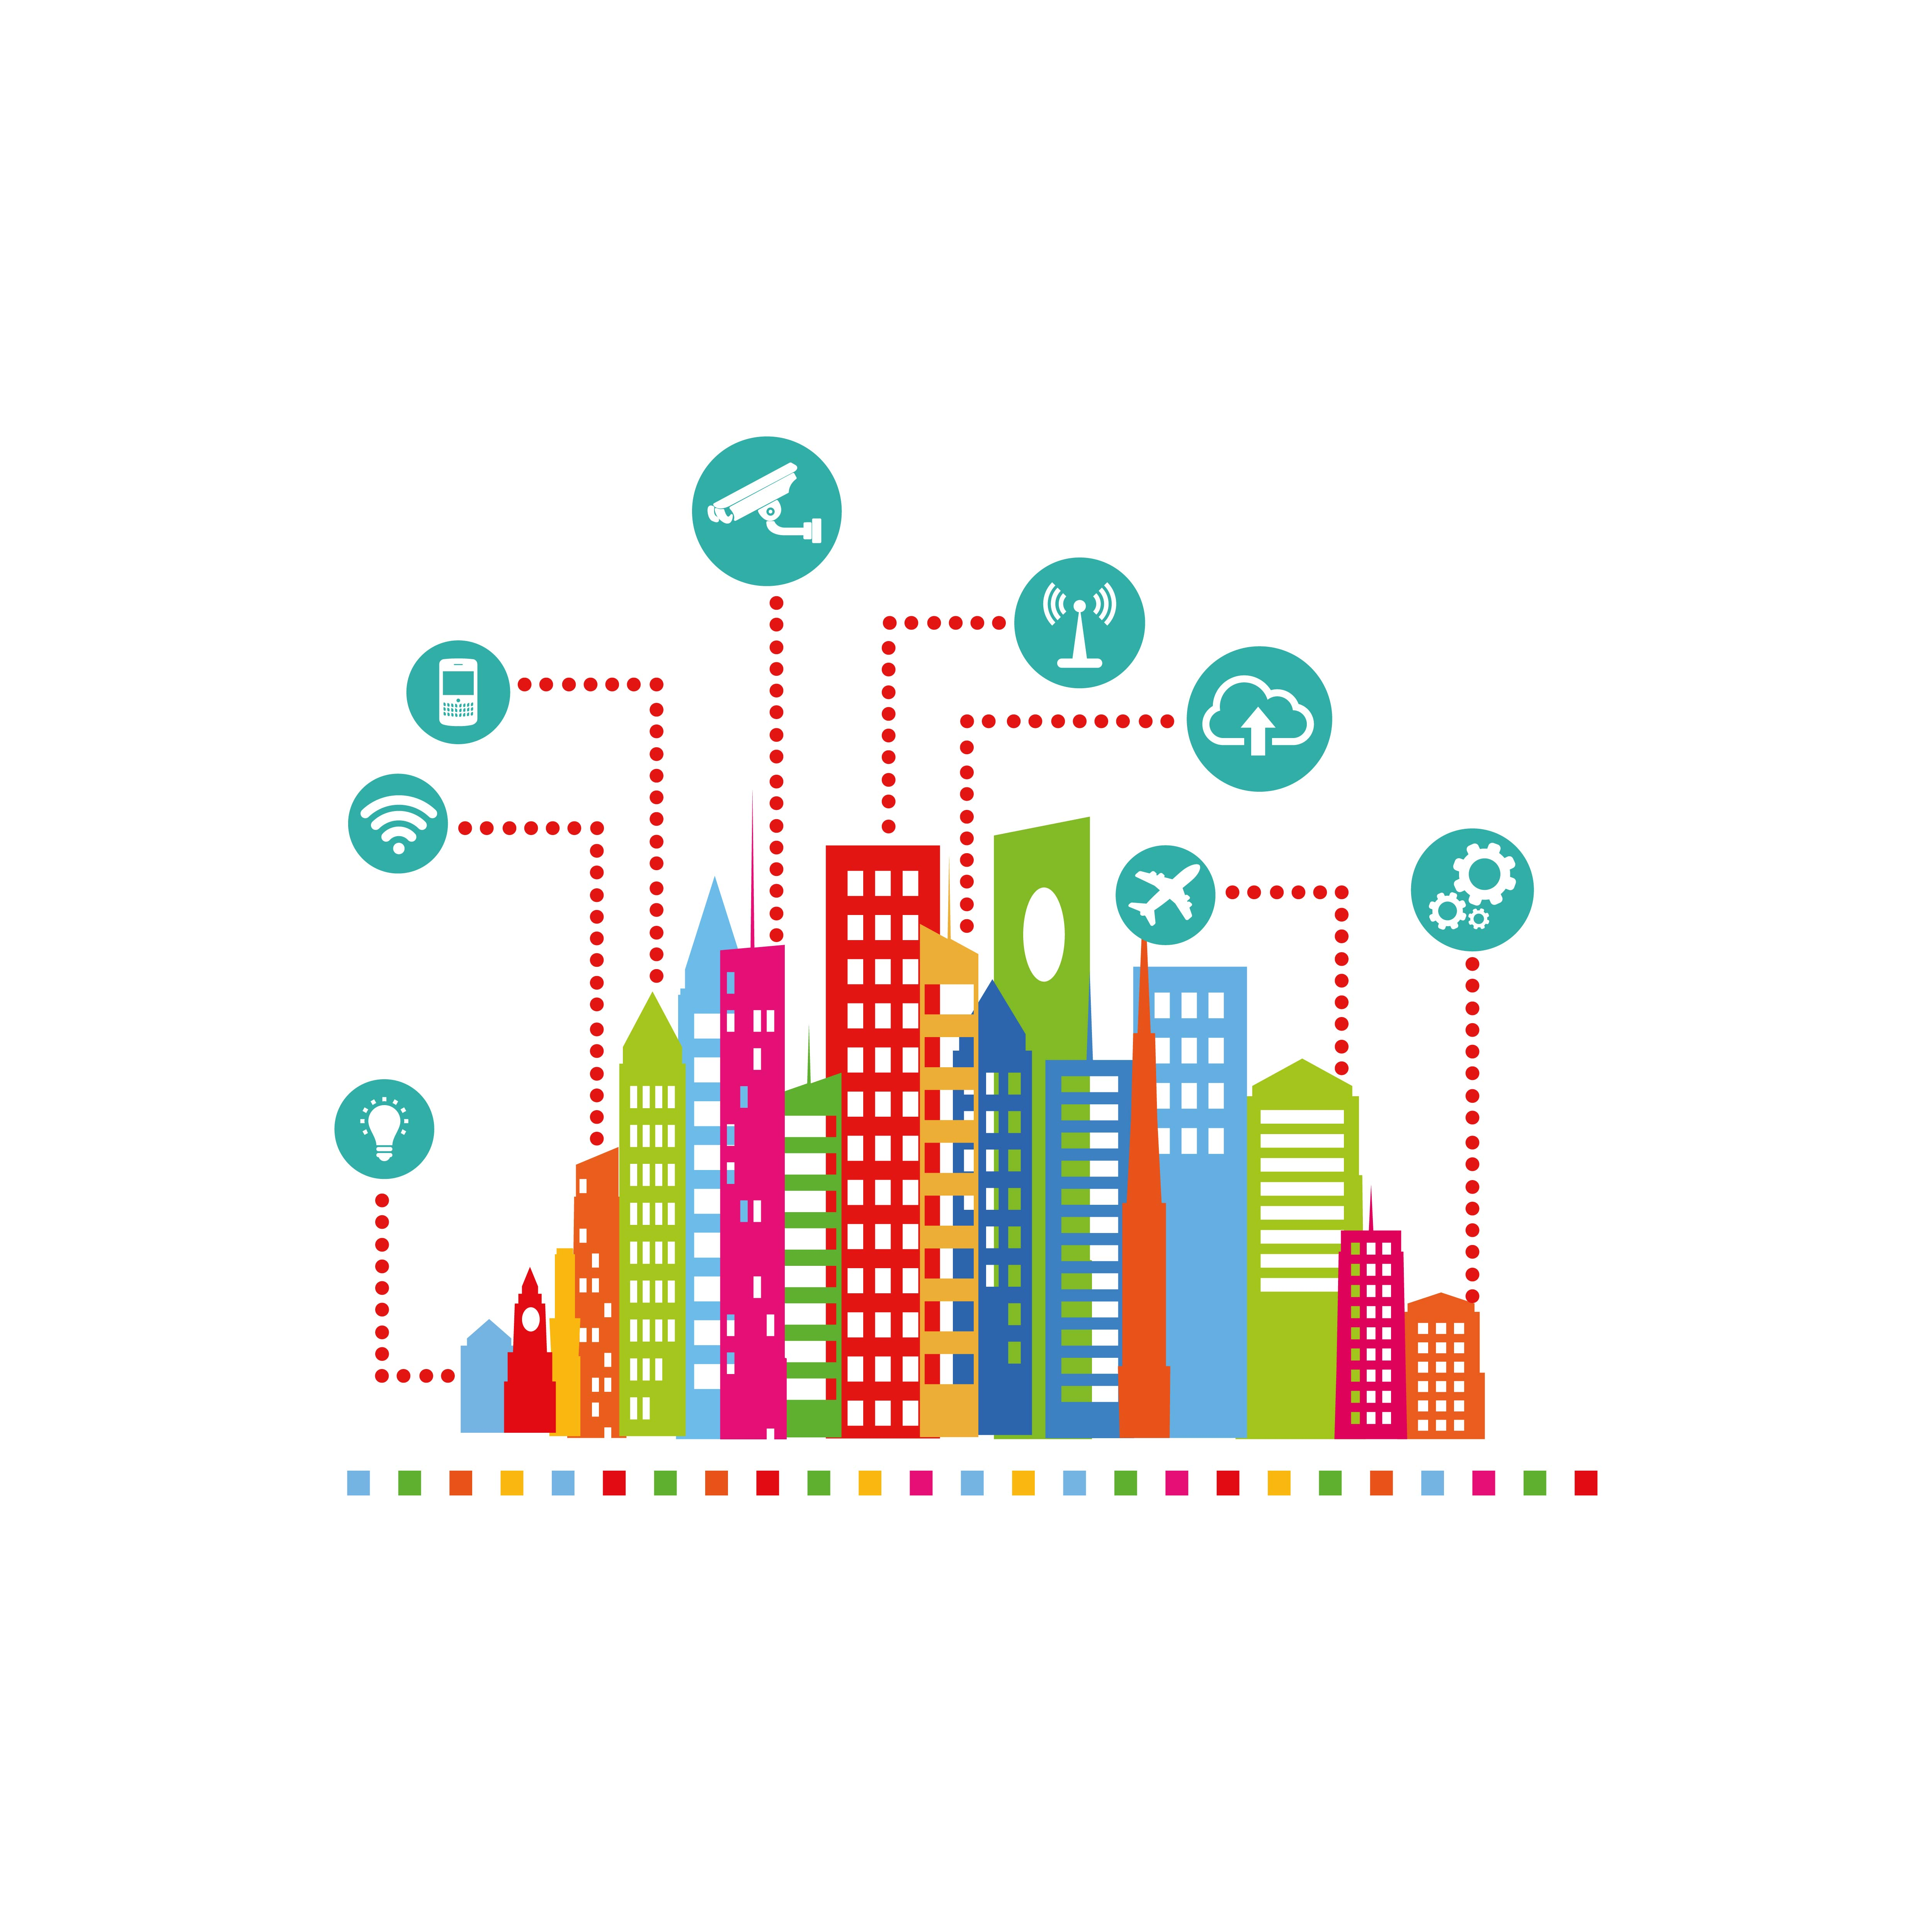
Smart and sustainable Cities

Slide 4
Goal 11: Make cities inclusive, safe, resilient and sustainable
Cities are hubs for ideas, commerce, culture, science, productivity, social development and much more. At their best, cities have enabled people to advance socially and economically.
Half of humanity – 3.5 billion people – lives in cities today
By 2030, almost 2/3 of the world’s population will live in urban areas
95 per cent of urban expansion in the next decades will take place in developing world
828 million people live in slums today and the number keeps rising
The world’s cities occupy just 3 per cent of the Earth’s land, but account for 60-80 per cent of energy consumption and 75 per cent of carbon emissions
Rapid urbanization is exerting pressure on fresh water supplies, sewage, the living environment, and public health
But the high density of cities can bring efficiency gains and technological innovation while reducing resource and energy consumption
http://www.un.org/sustainabledevelopment/sustainable-development-goals/

Slide 5
Internet of Things in Cities – Medellín

Slide 6
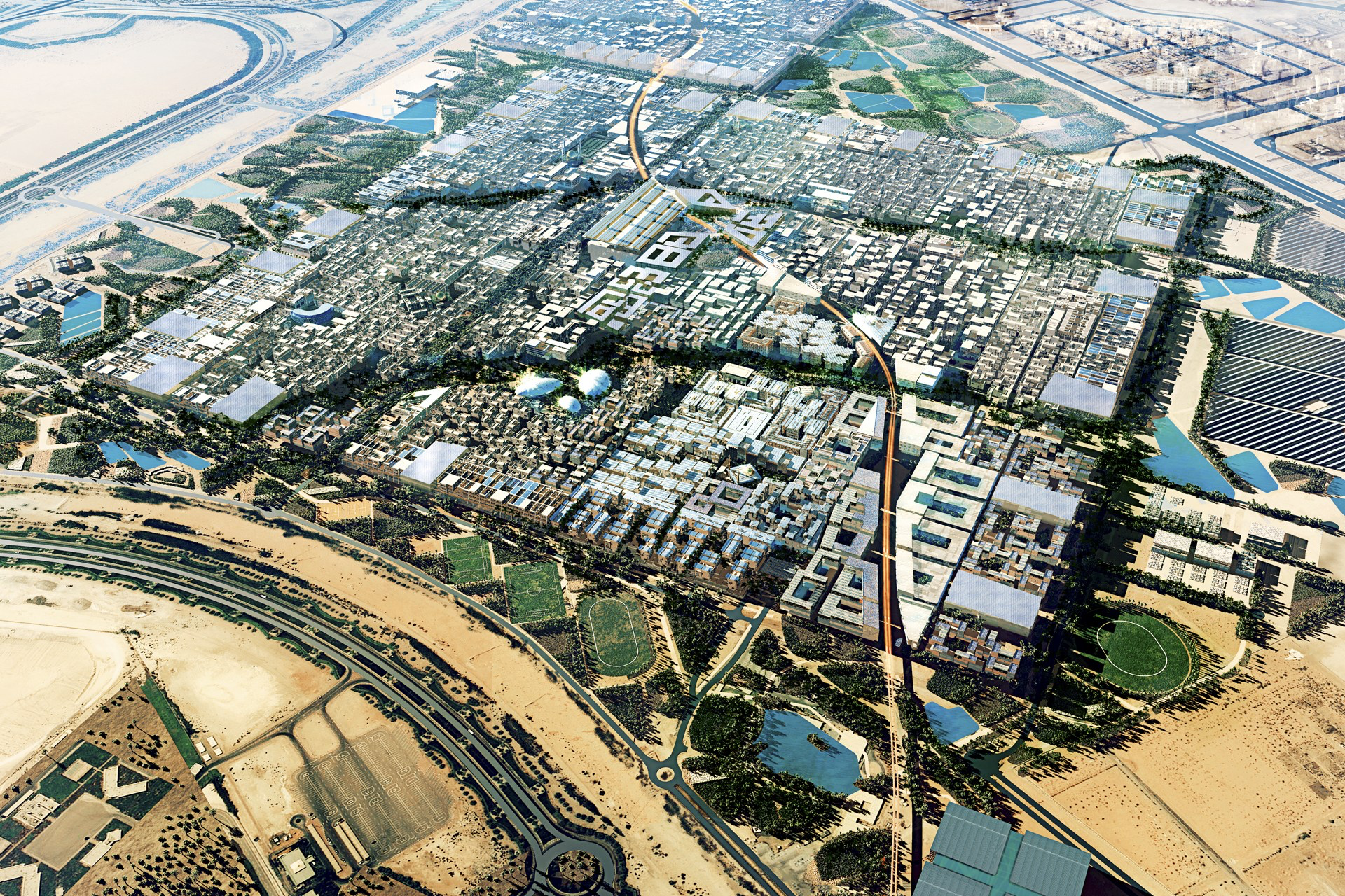
Internet of Things in Cities – Mazdar City
By 2016, the world's first climate-neutral city - Masdar City – was set to emerge from the sands of the Arabian desert.
Notes:
Eine Vorzeigestadt in der Wüste Abu Dhabis, das sollte Masdar City werden. Keine Emissionen. Kein Abfall. Wohnort für 50.000 Menschen. Ein Blueprint für die nachhaltige Stadt der Zukunft, richtungsweisend für Städteplaner weltweit.

Slide 7
Internet of Things in Cities – Mazdar City – reality only 5%
By 2016, the world's first climate-neutral city - Masdar City – was set to emerge from the sands of the Arabian desert.
Notes:
Eine Vorzeigestadt in der Wüste Abu Dhabis, das sollte Masdar City werden. Keine Emissionen. Kein Abfall. Wohnort für 50.000 Menschen. Ein Blueprint für die nachhaltige Stadt der Zukunft, richtungsweisend für Städteplaner weltweit.

Slide 8

National Luxembourg Digital Twin
The digital backbone to Innovation for Resilience and Sustainability

Slide 9
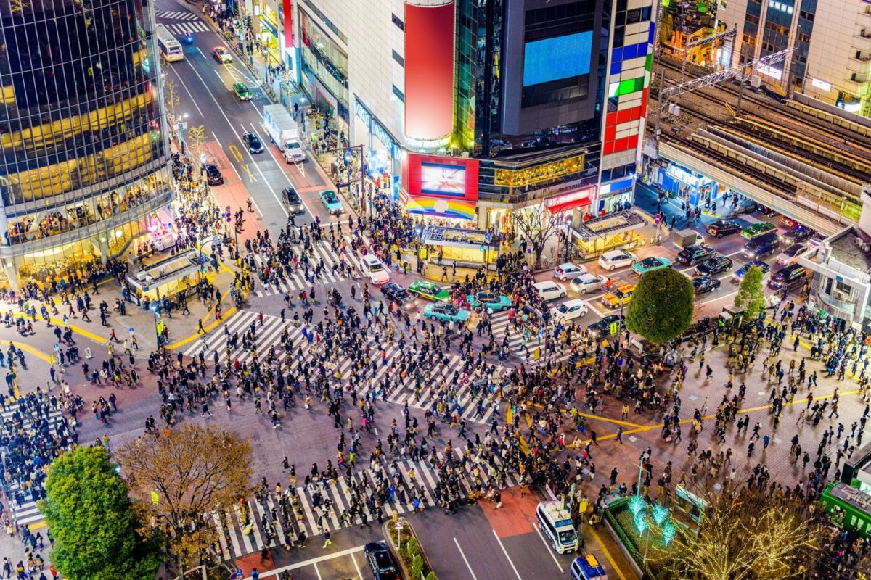
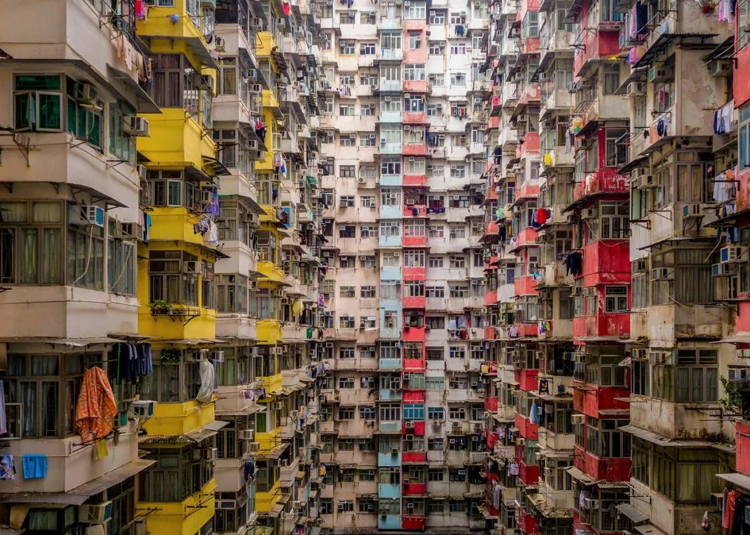
Condensed Spaces
Notes:
Atocha – Madrid 11.03.2004

Slide 10
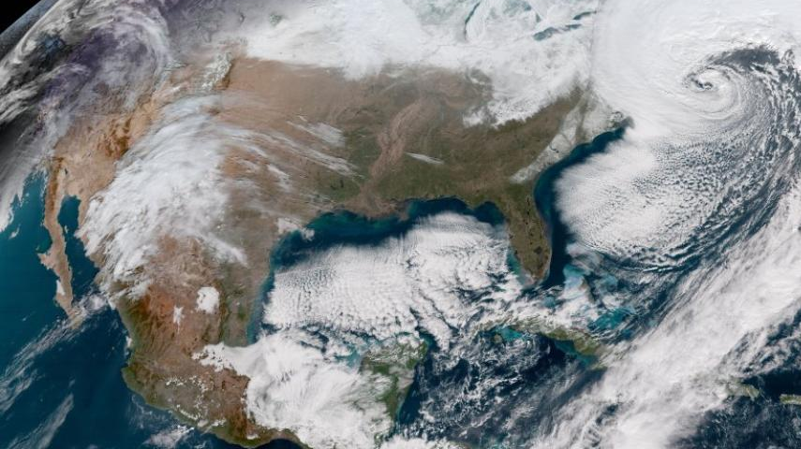
Global Warming
Notes:
The insurance statistics of the last few years show very clearly that there has been an immense increase in climate-related catastrophic events, indicated above all by heavy rain, landslides and floods. Extreme weather phenomena such as storm damage, heavy snowfall and late frost are also on the increase.
Cities generally have more complex risks than in rural areas. Natural hazards are one of the challenges - in Graz, for example, the danger of flooding from the Mur. But there are also other crisis events in Graz that challenge disaster management. Examples of this are the rampage of 2015 or the aerial bomb defusions in densely built-up residential areas.
Another challenge in urban areas is certainly the language and cultural barrier - just as communication in general is an important issue.
Most people are familiar with the classic siren signals. However, some new technologies are currently coming into play in this area. Many people are already familiar with the Katwarn app. The Stop Corona app is controversial in the media, but it also has its advantages. Internationally, CellBroadcasting has proven itself. Here you get an automatic message from your mobile phone provider if an emergency occurs in the area where you are at the moment.
We are becoming more vulnerable as a society. One main factor for this is certainly people's fully comprehensive mentality. The classic Austrian likes to rest on his laurels in the affluent society in which we live. The state and the authorities have created sufficient precautions so that you don't have to share the risk or make provisions for yourself. If there is a fire, the fire brigade comes. If there is a power failure, I assume that the power will be back on within a very short time. This attitude is a particular challenge in big cities, where many more people live in concentrated form than in the countryside.

Slide 11
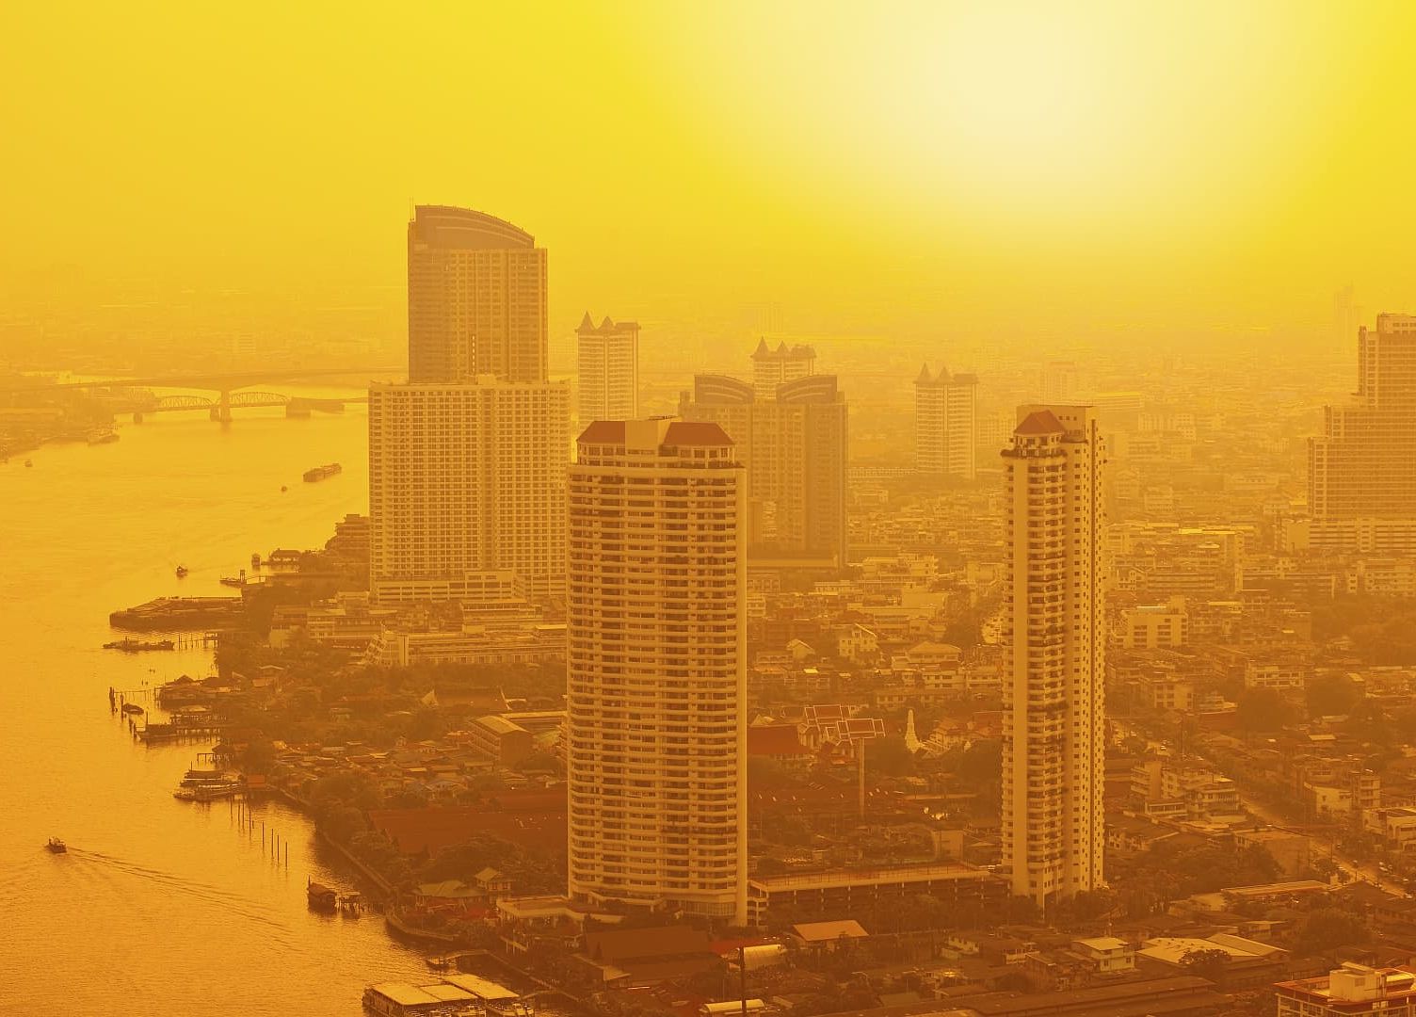
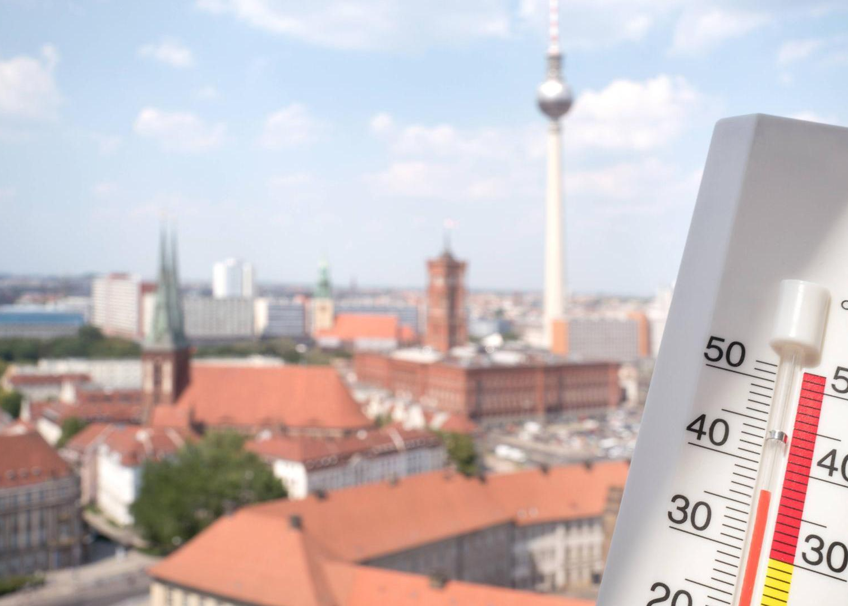
Heat
Notes:
Atocha – Madrid 11.03.2004

Slide 12
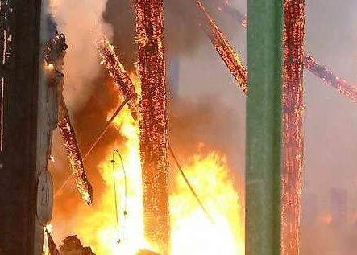
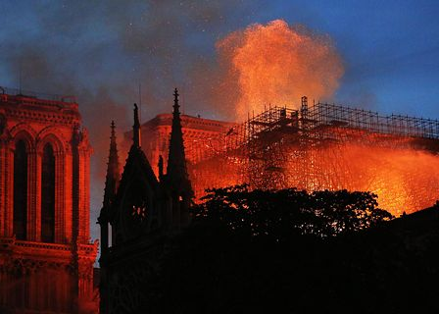
Fires

Slide 13
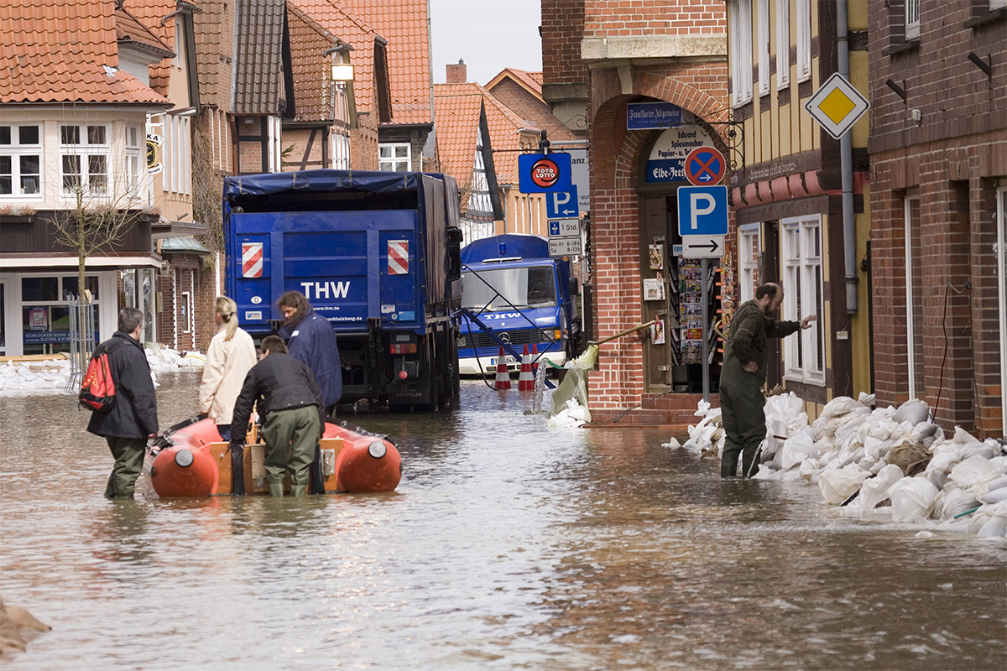
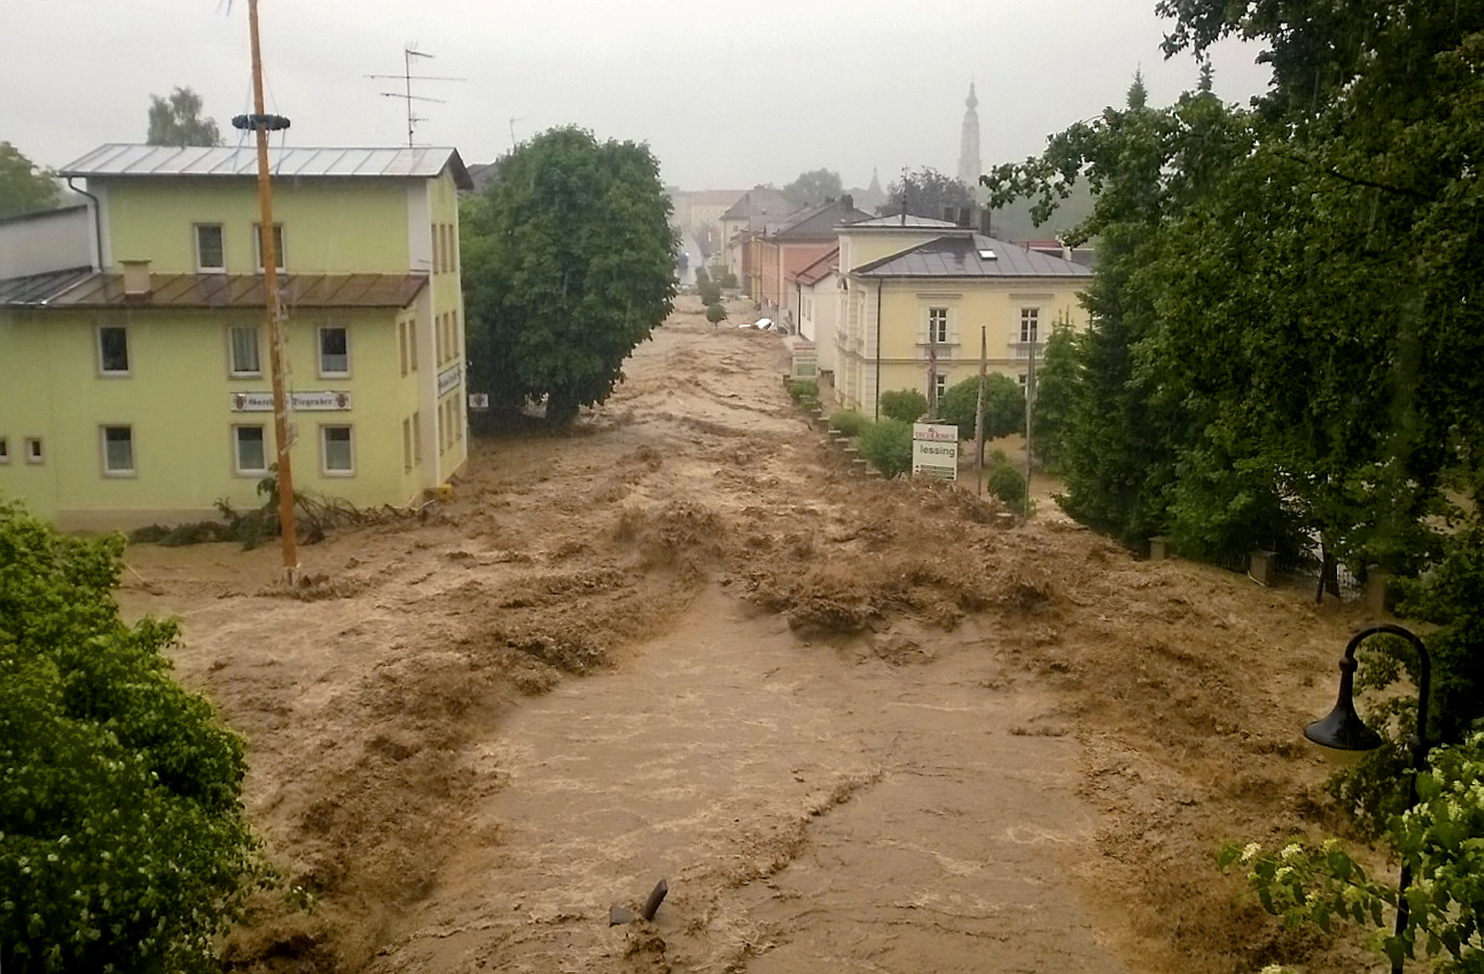
Floods

Slide 14

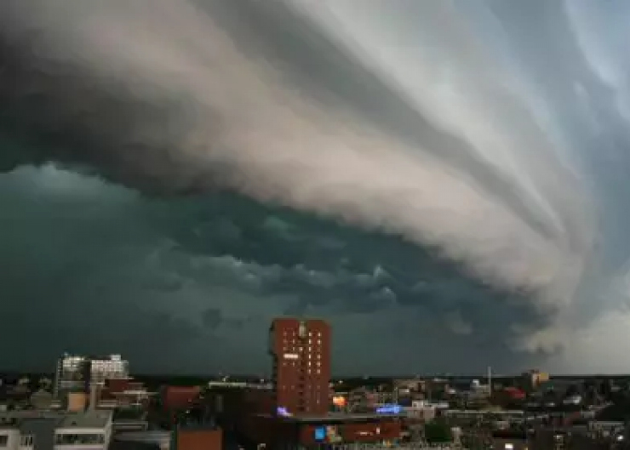
Wind and Wheather

Slide 15
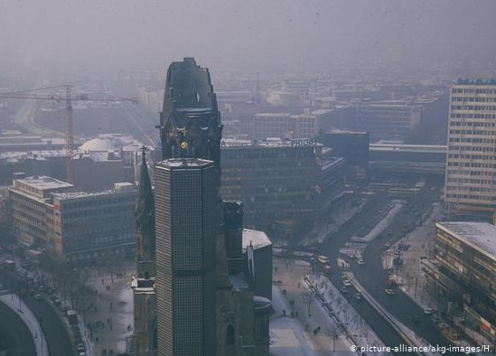
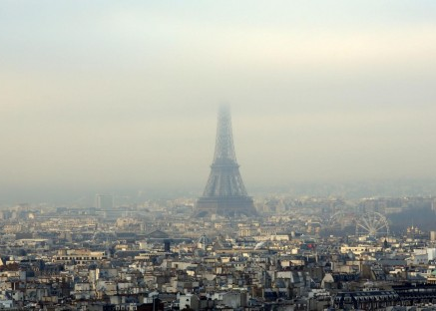
Smog
Notes:
Atocha – Madrid 11.03.2004

Slide 16
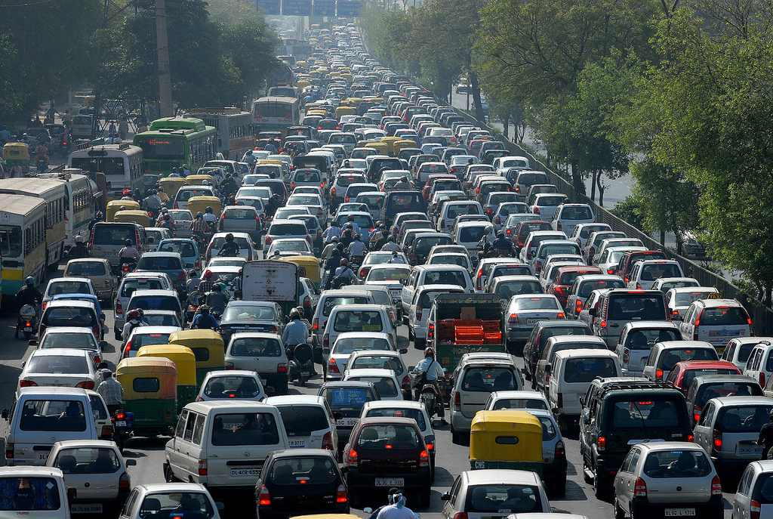
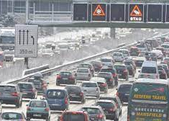
Traffic
Notes:
Atocha – Madrid 11.03.2004
During lockdown periods, most cities experienced a significant drop in automobile traffic and a subsequent reduction of air pollution and CO₂ emissions. As previously presented, in regions with lockdowns, there was a decrease of 50-75% in road transport activity and up to 95% in rush-hour traffic congestion in major cities, but these reductions have been temporary and have already been reversed in many cities re-emerging from lockdowns.
While most cities are already experiencing a sharp bounce-back as lockdown restrictions are being eased, the recent experience of reduced traffic and pollution has motivated many city leaders to pursue cleaner and more sustainable urban mobility. The most common sustainable urban mobility measures proposed by cities include investment in: active mobility infrastructure, such as bike lanes; improved public transport safety and accessibility, such as improved hygiene measures, contactless fare payment and broader service coverage; and low-emission transport options, such as electric vehicles and scooters. These investment options are in line with the overarching objective of an economic recovery, as infrastructure investment creates job opportunities and stimulates private investment in diverse economic sectors (e.g. construction, automobile, ICT), and as an effective urban mobility system is essential for the productivity of cities.

Slide 17
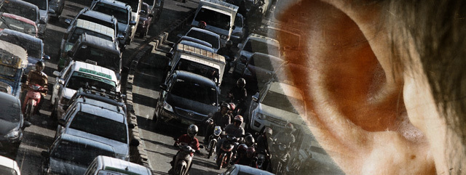
Noise
Notes:
Atocha – Madrid 11.03.2004
During lockdown periods, most cities experienced a significant drop in automobile traffic and a subsequent reduction of air pollution and CO₂ emissions. As previously presented, in regions with lockdowns, there was a decrease of 50-75% in road transport activity and up to 95% in rush-hour traffic congestion in major cities, but these reductions have been temporary and have already been reversed in many cities re-emerging from lockdowns.
While most cities are already experiencing a sharp bounce-back as lockdown restrictions are being eased, the recent experience of reduced traffic and pollution has motivated many city leaders to pursue cleaner and more sustainable urban mobility. The most common sustainable urban mobility measures proposed by cities include investment in: active mobility infrastructure, such as bike lanes; improved public transport safety and accessibility, such as improved hygiene measures, contactless fare payment and broader service coverage; and low-emission transport options, such as electric vehicles and scooters. These investment options are in line with the overarching objective of an economic recovery, as infrastructure investment creates job opportunities and stimulates private investment in diverse economic sectors (e.g. construction, automobile, ICT), and as an effective urban mobility system is essential for the productivity of cities.

Slide 18
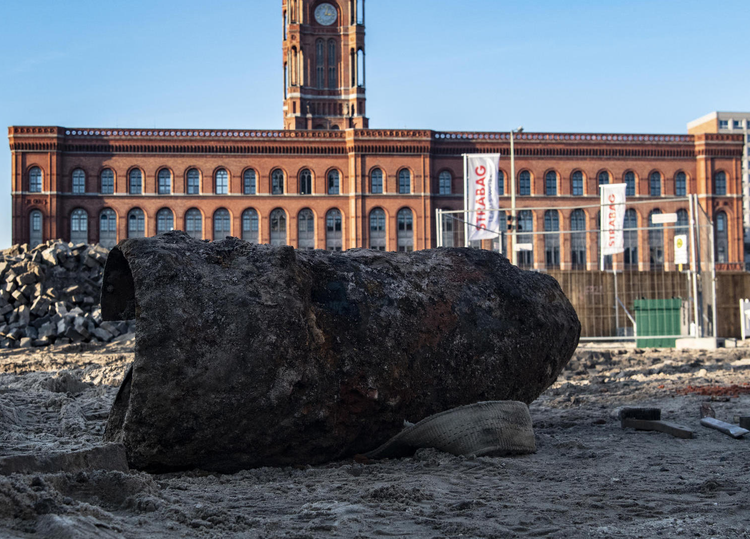
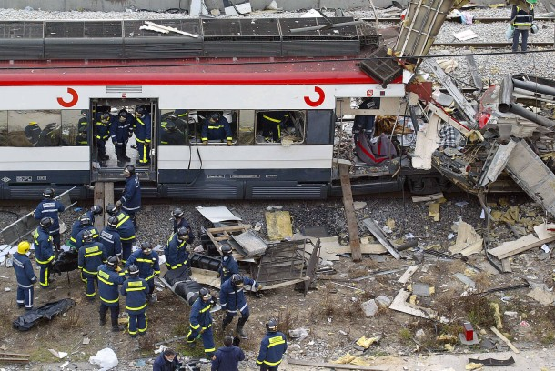
Other Threads
Notes:
Atocha – Madrid 11.03.2004

Slide 19

Power Outage

Slide 20
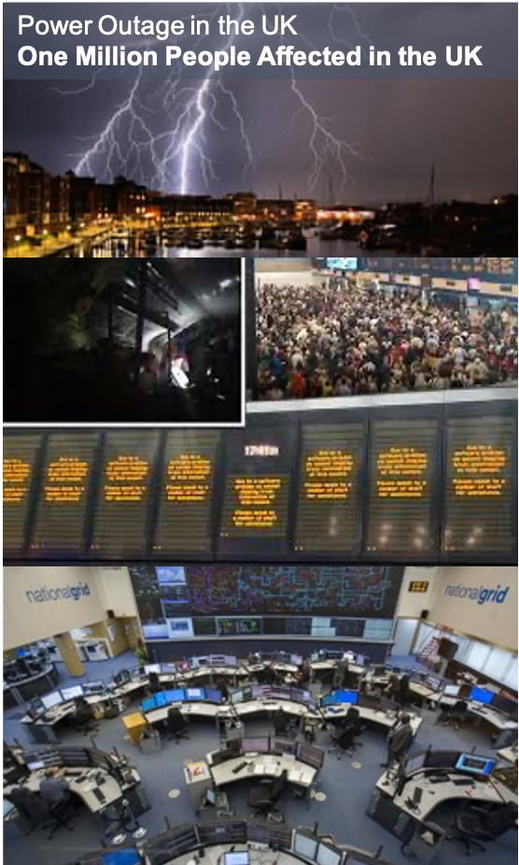
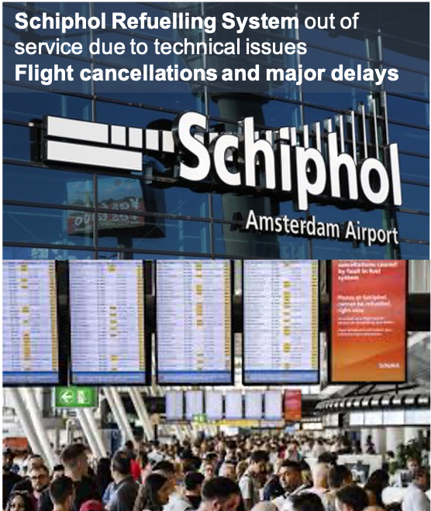
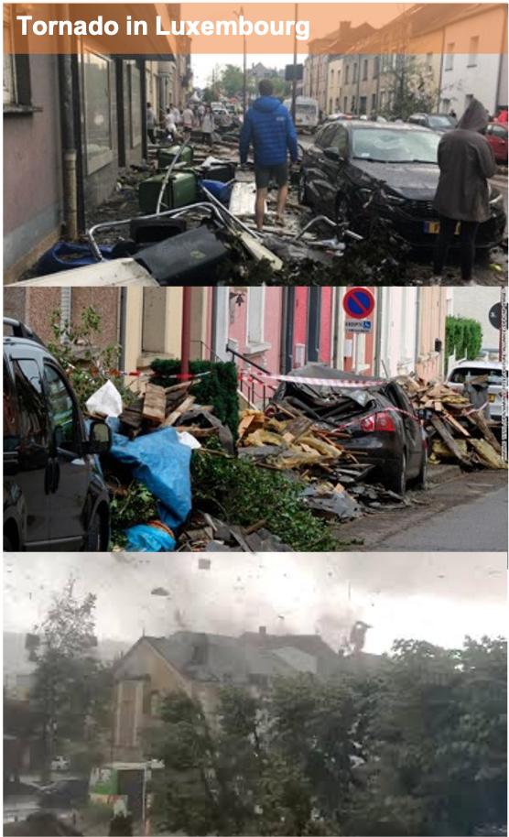
Recent Threads
in Europe
Notes:
From 9 to 19 August 2019, a major power blackout hits parts of England and Wales, affecting nearly a million people and causing widespread travel disruption. The failure has been blamed on a lightning strike
Aircraft Fuel Supply, the airport’s third-party fuel supplier, had a fault in their power system at around 13:00 on Wednesday 24th July 2019. For safety reasons and following established protocol, the system turned itself off. As a result, the piping system lost pressure, which meant that aircraft could not then be refuelled.
Am Freitag, den 9. August 2019, zog gegen 17:40 Uhr Lokalzeit ein Tornado über die Ortschaften Rodange, Lamadelaine, Pétange und Bascharage im Südwesten von Luxemburg hinweg.

Slide 21
Fragile
Resilient
Anti-fragile
Notes:
Qqqqqqqqqqq^^

Slide 22
National Luxembourg Digital Twin
The digital backbone to Innovation for Resilience and Sustainability
Researchers
Companies
Public authorities
Citizens
A unique, open Innovation Platform
Test bed for digital services and products
Better decisions
Better
quality of life

Slide 23
Urban
Planning
Resources mgmt
Energy
system
Mobility & Logistics
Information SystemNW
Agriculture
Bioindustry
Industry 4.0
Regulation
Education
Health
Researchers
Companies
Public authorities
Citizens
A unique, open Innovation Platform
Test bed for digital services and products
Better decisions
Better
quality of life

Slide 24
Urban
Planning
Resources mgmt
Energy
system
Mobility & Logistics
Information SystemNW
Agriculture
Bioindustry
Industry 4.0
Regulation
Education
Health

Slide 25



Sustainable and resilient Energy systems
Notes:
Energy transition is well under go to help us obtaining the climate and energy goals in upcoming years.
This however creates challenges when penetration of renewable energy sources and other distributed energy resources increases much faster than the development of grid infrastructures… uncertainties from variable renewable generation like solar PVs or stochastic consumption pattern of DERs like EV charging leads to violation of voltage variations at the connection point or local grid congestions. In a larger extend, this is an uncertainty in balancing energy supply and demand of the whole energy systems.
Meanwhile, we are seeing number of DER units forming their own autonomous energy areas (so-called connected energy clusters like EV fleets or net zero-energy Buildings) which is quite complex to manage in a traditional top-down manner. There must be a paradigms shift from centralized to decentralized control and management of such resources at the local levels of the grids.
Having a closer loop at the situation of Luxembourg, we can see the same issues. Among other, Rifkin report about the 3rd industry revolution has highlighted the importance of digital transformation which is considered as a converging technology to support the energy transition of the country in upcoming this. This is in-line with the proposal eDEAL to enable somehow Energy Internet concept….

Slide 26
Challenges ahead: eXplainable AI
The digital backbone to Innovation for Resilience and Sustainability
Decision support
Closed Loop System
Distributed
Long-term planing
XAI
Anti-Fragility
short-term
market dynamics
Security & Privacy
Energy vectors

Slide 27

Covid-19

Slide 28

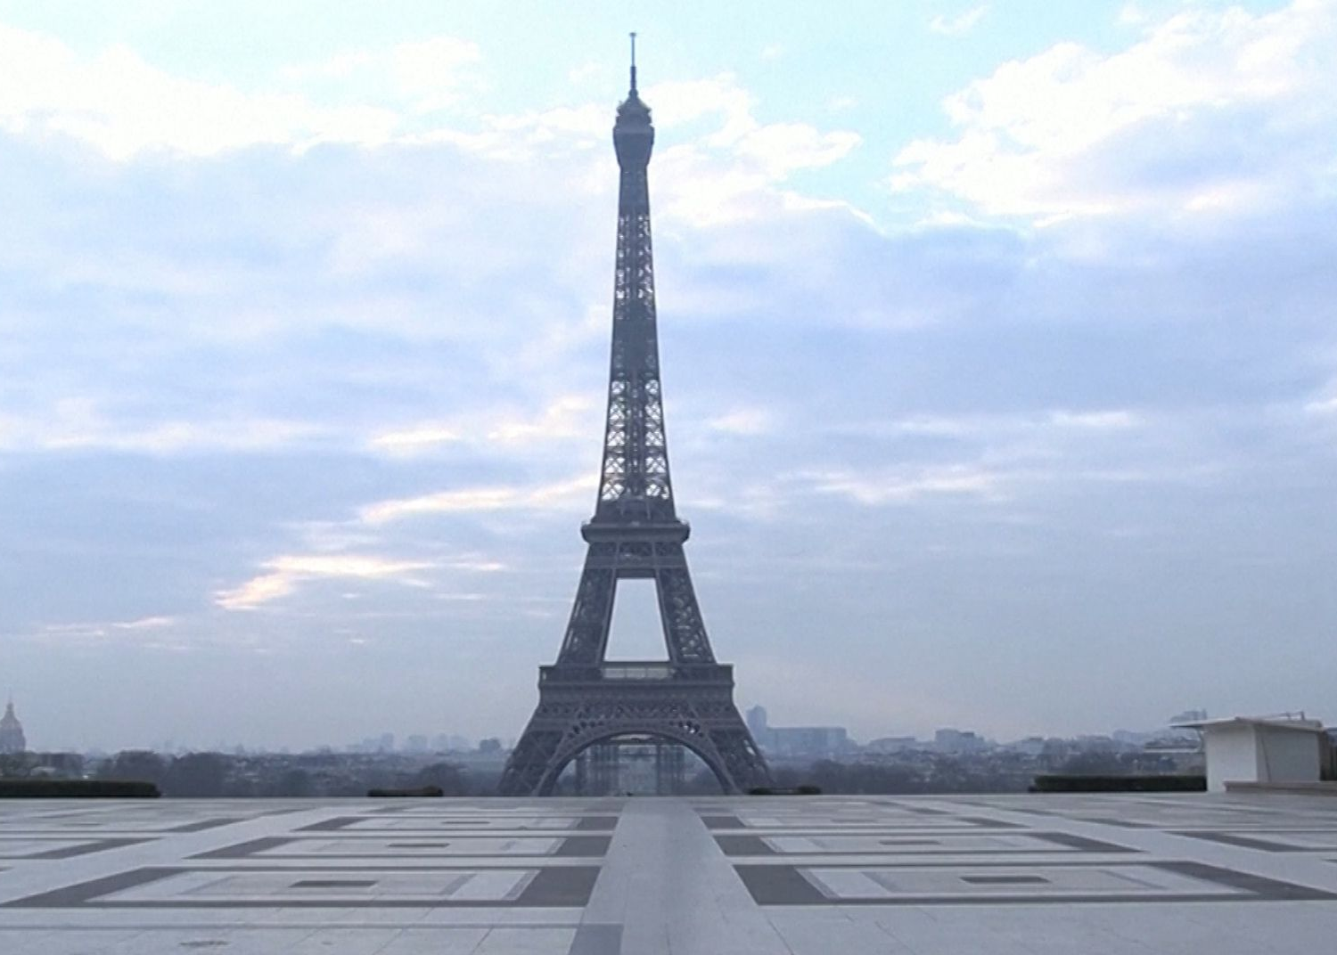
COVID
Notes:
Atocha – Madrid 11.03.2004

Slide 29
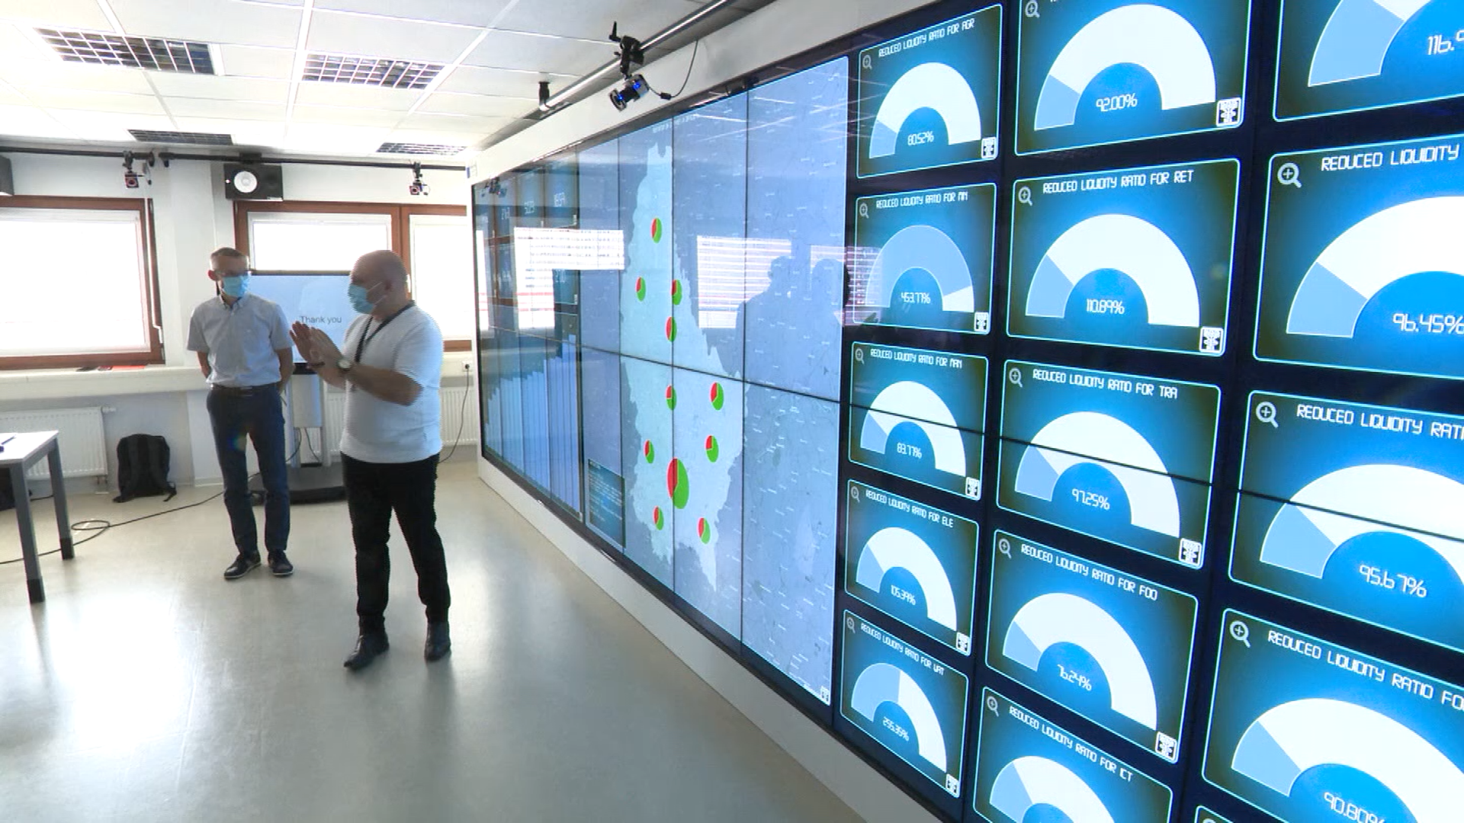

Slide 30
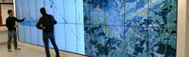
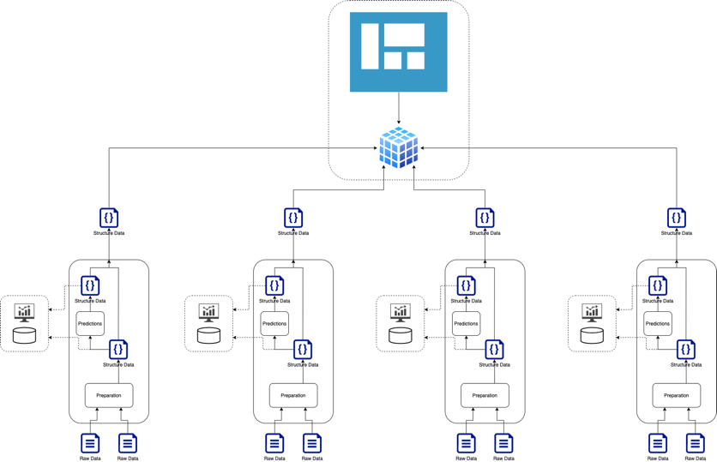






COVID DASHBOARD
Cross-Functional Dashboard
cross domain dashboard
Web technologies
access the verticals APIs
Data exposed via the global dashboard
API giving access to ready to use data from verticals
Open to new partners to add other verticals or to enrich existing ones
Covid projects
Large-Scale Testing
Epidemio-Health
Socio-Economics
Logistics / Essential Services

Slide 31

Behind the scene: The digital twin SW stack
Visualisation wall + Interactive devices
hardware
LIST DEBORAH middleware
Team of skilled Researchers & Engineers
Visu. applications
Visu. applications
…
Partners
software
Software layers
Powerful cluster of dedicated servers
hardware
Co-funded by

Slide 32
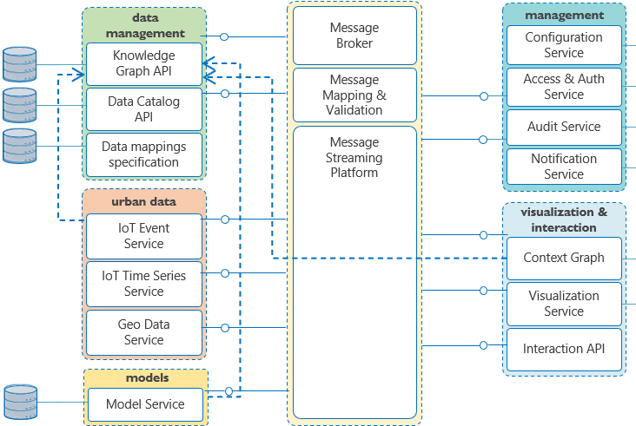
Behind the scene: The Digital Twin SW layers

Slide 33
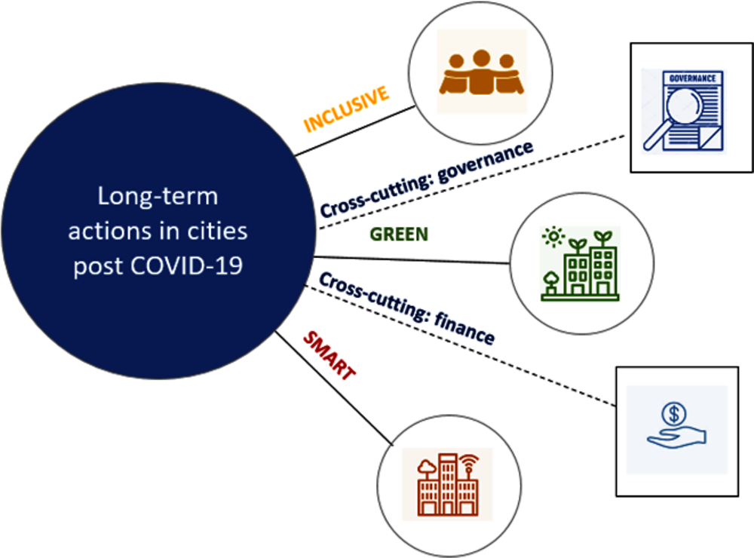
Notes:
OECD: Life after COVID-19 - prompting cities to rethink how they deliver services, how they plan their space and how they can resume economic growth!
From extensive use of digital solutions, to decentralised production, remanufacturing, and restructuring of supply chains to respond to goods shortages. Civic duty and community involvement are prevailing over individual interest to protect vulnerable groups. This can inspire lasting behavioural shifts to make cities more resilient and more efficiently connected with rural areas, in terms of the way goods are produced, energy consumed and transport organised.
Cities can accelerate their efforts to put in place actions to become more resilient, greener, circular and smarter, before a new crisis may hit!
Effective risk management: preparation, prevention and response.
INCLUSIVE: investing in education and skill development to support the most vulnerable people and make the post COVID-19 society more inclusive
Latest city strategies for long-term recovery from the COVID-19 pandemic and towards resilience to future shocks:
Three cross-cutting sections focus on strategies related to: i) inclusive recovery, ii) green recovery, and iii) smart recovery; and two additional sections provide a deep dive into iv) recovery strategies in the tourism, culture and creative industries; and v) holistic strategies for urban resilience.
city administrations also have a role to play in developing locally tailored recovery strategies, boosting local economy with public investment and supporting small and medium enterprises. Many cities have developed recovery visions or plans, with a broad range of stimulus measures, including investment in infrastructure, tax reduction and financial assistance:

Slide 34


Sustainability

Slide 35
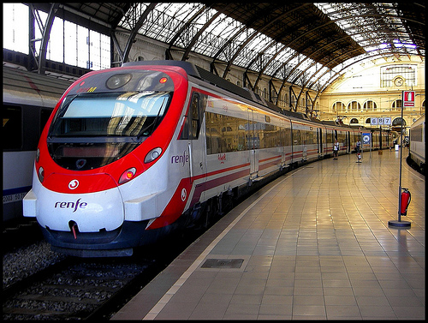

Reduction of Energy consumption of a Metro station in Barcelona by 5% under real operational conditions

Slide 36
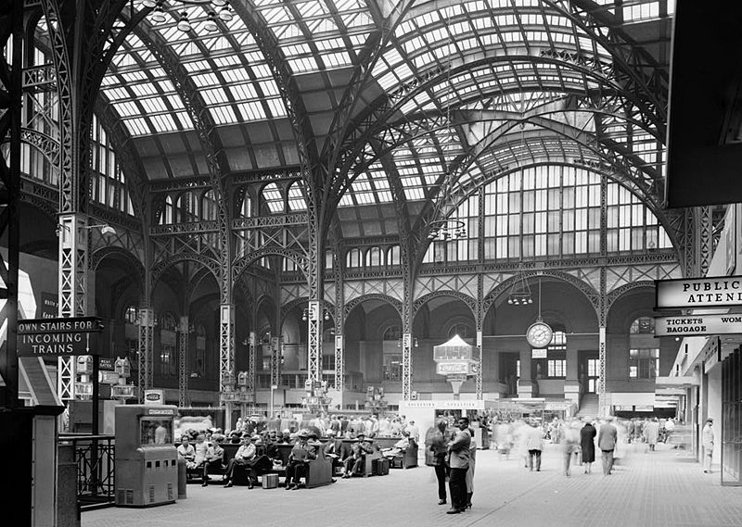
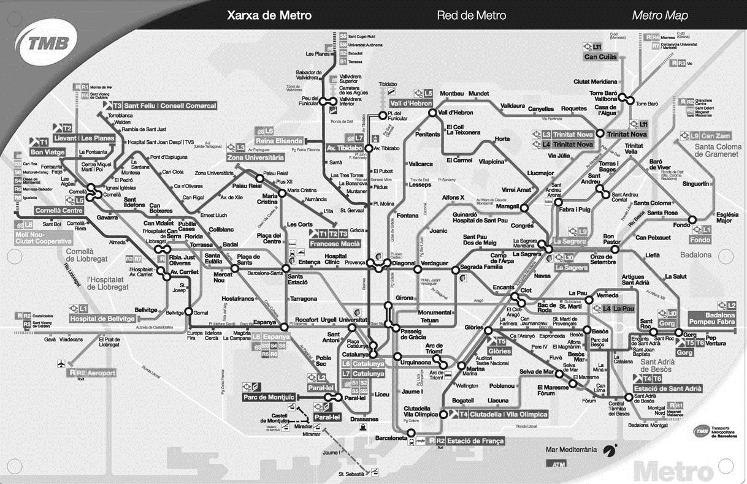
Metros are large Energy consumers - Barcelona Metro Network uses 63,1 Millions kWh/year
A third is used by the Metro stations
Savings of 5% per year, equivalents to the average consumption of 700 households

Slide 37
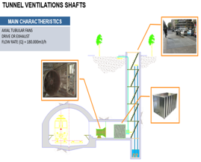
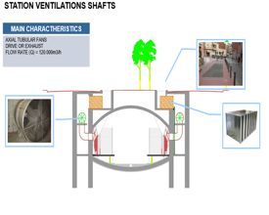
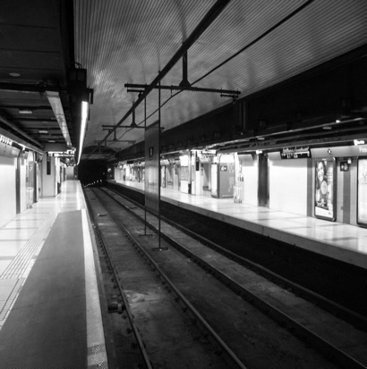

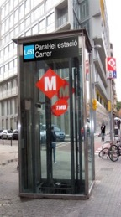
intelligent ventilation control
intelligent Light control
optimized transportation

Slide 38
Reduction Potential

Slide 39


Slide 40
The XAI challenge: Explainability vs Accuracy
XAI
Courtesy of Microsoft.
Reference: Preet Gandhi, NVIDIA: https://www.kdnuggets.com/2019/01/explainable-ai.html

Slide 41
Behind the scene: The Digital Twin Architecture
Visualisation wall + Interactive devices
hardware
LIST DEBORAH middleware
Team of skilled Researchers & Engineers
Visu. applications
Visu. applications
…
Partners
software
Software layers
Powerful cluster of dedicated servers
hardware
Co-funded by

Slide 42
Covid-19

Slide 43

Anti-Fragility

Slide 44
Problems you choose and problems that choose you
Towards a Digital
& Resilient (anti-fragile)
Society

